Slide 1
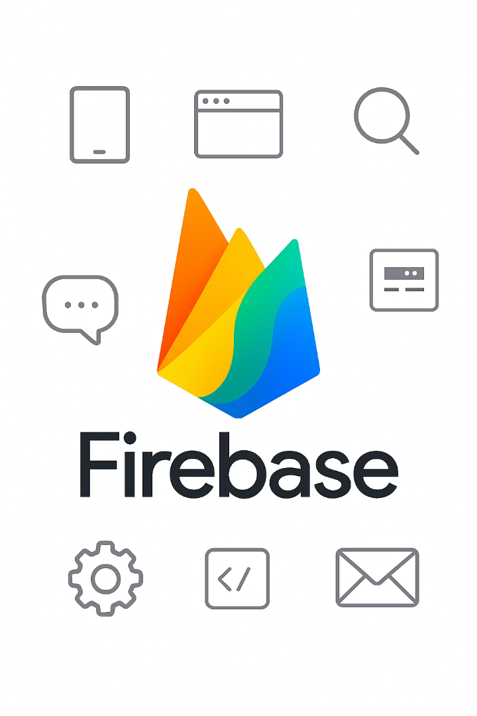
Introduction to Firebase
Firebase, developed by Google, is a robust platform for building mobile and web applications. As a back-end as a service (BaaS), it provides tools and infrastructure to create, enhance, and scale applications.

Slide 2





What is Firebase?
Back-end as a Service
A comprehensive suite of cloud-based services for app development.
Development Accelerator
Streamlines development with prebuilt services.
Team-Friendly
Particularly appealing to beginners and small teams.
No Server Setup
Eliminates need to write back-end code from scratch.

Slide 3

Key Features of Firebase
Real-time Database
Cloud Functions
Analytics
NoSQL database storing data in JSON format with real-time syncing across all clients.
Run back-end code in response to events for notifications, payments, or scheduled jobs.
Provides insights into user interactions, tracks behavior, and measures campaign performance.

Slide 4




More Firebase Features
Crashlytics
Monitors app stability in real time with detailed reports on crashes and errors.
Performance Monitoring
Provides metrics on app startup time and network request latencies.
Authentication
Secure user sign-in and access control for applications.

Slide 5
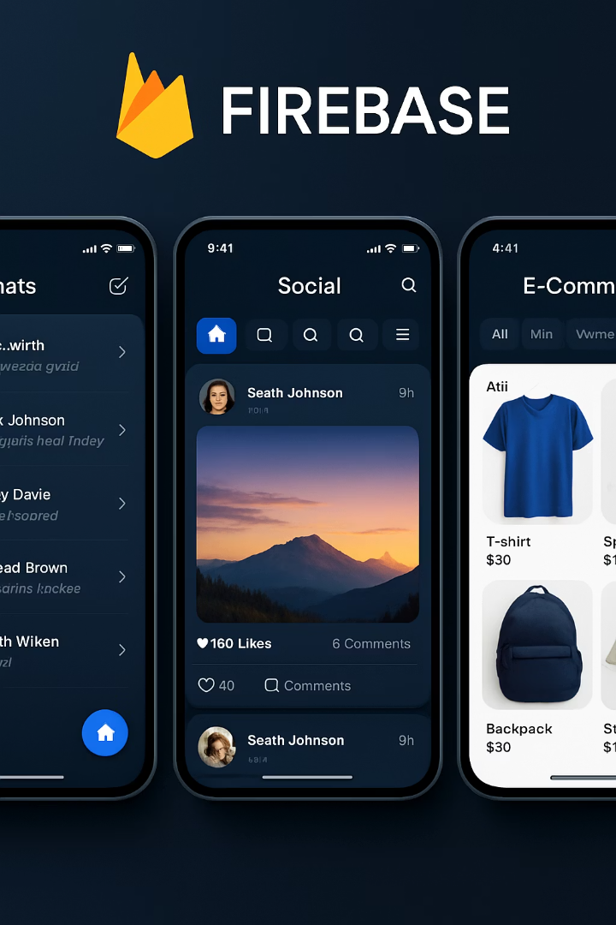
Firebase Use Cases
Chat Applications
Social Media Platforms
Real-time database syncs messages instantly across all devices without requiring refresh.
Authentication, storage, and databases for uploading photos, videos, and user interactions.
E-commerce Apps
Flexible databases and authentication with Firestore for product listings and Cloud Functions for payments.

Slide 6
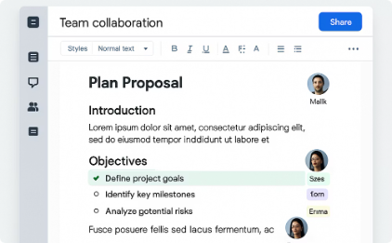


More Firebase Use Cases
Collaboration Tools
Real-time syncing for multiple users working together on shared documents or project management.
Games
Save player progress, store scores, manage accounts, and analyze player behavior.
Real-time Applications
Perfect for any app requiring instant updates across multiple devices.

Slide 7






Competing Platforms
Microsoft Azure Mobile Apps
Back-end services for mobile applications including data storage, authentication, and push notifications.
AWS Amplify
BaaS solution with authentication, storage, and APIs that integrates with other AWS services.
Backendless
Comprehensive set of back-end development tools including databases, file storage, and user management.

Slide 8










Where Firebase Excels
Google Integration
Seamless integration with Google products
Community Support
Large developer community with resources
Scalability
Handles growth from few to millions of users
Comprehensive Suite
All services under one roof
Simplicity
Intuitive console and well-documented SDKs

Slide 9





Real-time Collaboration Benefits
Instant Synchronization
Data syncs in real time across all connected clients.
Seamless Teamwork
Multiple people can work on the same project simultaneously.
Enhanced Efficiency
Streamlines the design and development process.
Reduced Conflicts
Minimizes version control issues and data conflicts.

Slide 10

Key Takeaways
Simplified Development
Firebase offers a back-end-as-a-service model with tools for databases, authentication, and hosting.
Versatile Applications
Used for chat apps, social media, e-commerce, collaboration tools, and games.
Competitive Advantage
Excels in ease-of-use, real-time synchronization, comprehensive tools, and Google integration.

